Slide 1
Computer Vision Based Robust Fruit Counting
Efe Oğuzkurt 27935
Ulvi Musayev 28629
Ahmet Bahadır Özer 26804
Supervisor: Erchan Aptoula
Date: 10/06/2023

Slide 2
Table of Contents
Executive Summary
Problem Statement/Summary
Objectives/Tasks
Related Work
Methodology
Results & Discussion
References

Slide 3
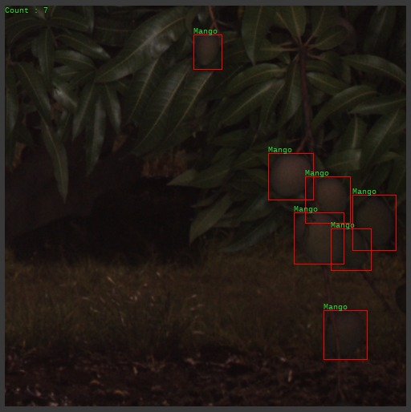
Executive Summary
Problem of object detection
Easy for humans on a smaller scale
Almost impossible to do in an industrial environment
Technology/computers/programming needed to automate it
Object detection in programming
Aim to implement object detection in agriculture
Counting the number of fruits in an image
Needs an efficient and accurate algorithm, and data sets
Different methods have been developed for similar purposes
Objective is the find/develop a method most suitable for our type of data
Basic representation of object detection in fruit counting

Slide 4
Problem Summary
Accurate and efficient fruit counting: crucial for agricultural applications
Yield estimation, resource management, inventory
Manual counting is labor-intensive and prone to error
AI and computer vision offer automation
The problem lies in correctly training the model
Mainly addressed problem: A pre-trained model designed for mangoes, has difficulty generalizing to apples, almonds etc.
All 3 possess different characteristics.
The model leads to inaccurate results for mangoes and almonds

Slide 5
Problem Summary
Proposition: Domain adaptation combined with Faster R-CNN
Domain adaptation closes the gap between source and target domains
This enables the model to adapt to different fruits
Main challenge: Curating a dataset with diverse fruits, and accurate labeling
Adaptation retains source domain (mangoes) info, and adapts to counting almonds

Slide 6
Problem Summary
Correct automation can revolutionize orchard fruit counting
Automation would:
save time and resources for farmers
improve data quality

Slide 7
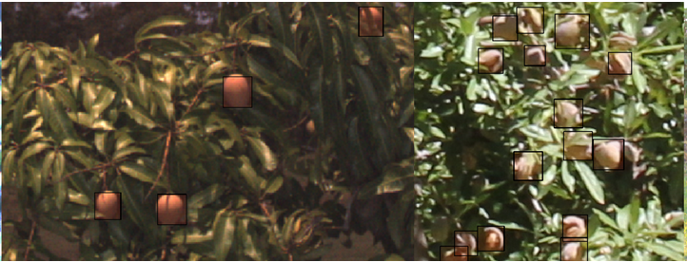
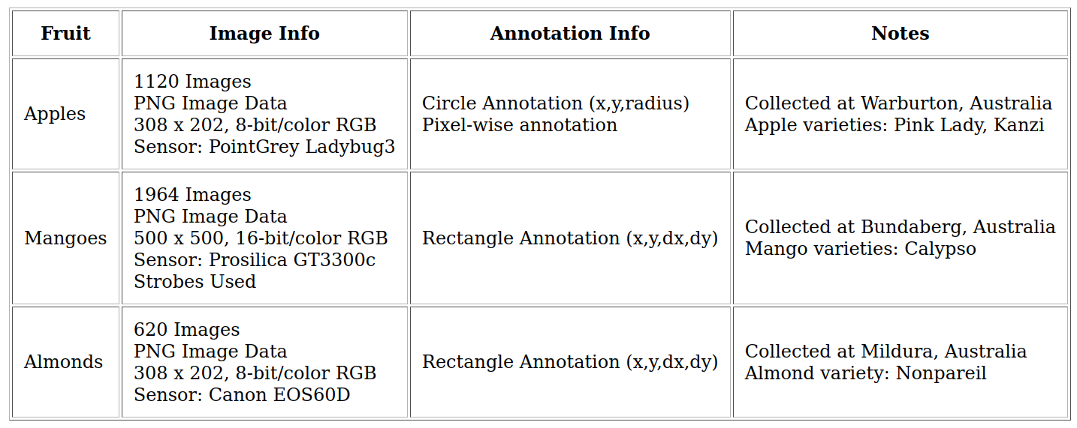
Objectives/Tasks
Finding a suitable dataset:
ACFR Orchard Fruit Dataset

Slide 8
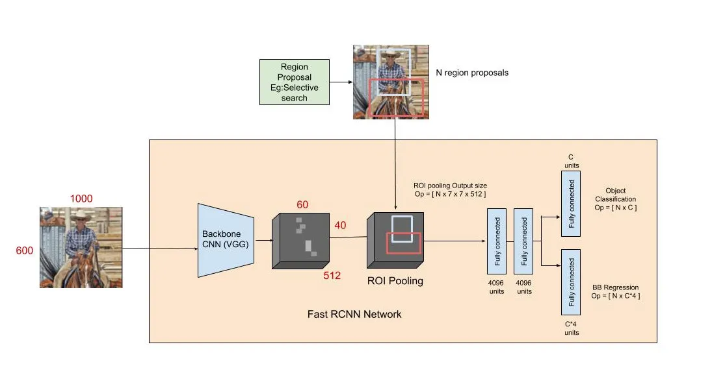
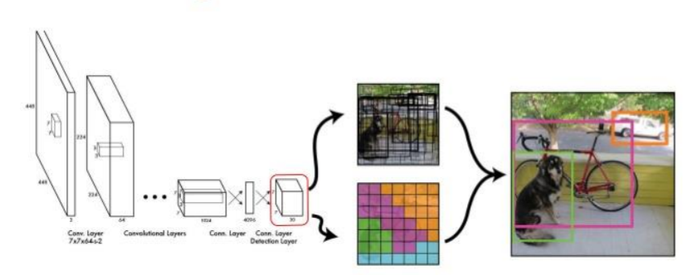
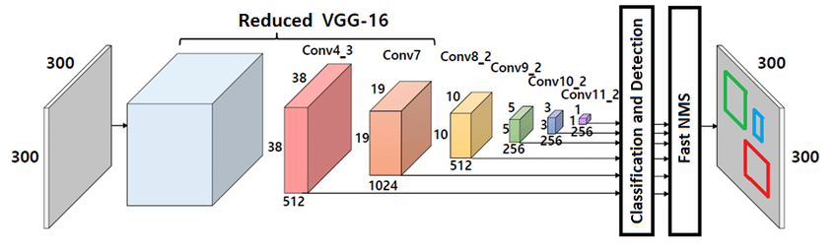
Objectives/Tasks
Choosing which framework to work with
Faster RCNN
YOLO
SSD

Slide 9
Related Work
You Only Look Once / YOLO (Tan L. et al., 2021)
Uses simple convolutional neural networks (CNN)
Finding probabilities for bounding boxes
Full image training to optimize performance
Single Shot Detector / SSD (Liu W. et al., 2016)
A specific model designed in this paper
Claims to be faster then older YOLO models
Evaluates smaller boxes for efficiency
Predicts shape and confidence values, produces model loss
The architecture representation of SSD

Slide 10
Related Work
Architecture representation of Faster R-CNN
Faster R-CNN / Region-Based CNN (Girshick, 2015)
Takes the entire image and object proposals as input
Processes image by pooling layers, forms a convolutional feature map
Region of interest latest extract feature vectors
Fed into connected layers to output to two branches
Branch 1: Produces softmax probability estimates for K object classes
Branch 2: Produces for real numbers for each object class that encode bounding box positions
Faster R-CNN efficiently detects objects in a wide application range

Slide 11
Methodology
Annotation manipulation and custom dataloaders
Faster RCNN framework
Resnet50_fpn backbone with custom classification and region proposal layers
Stochastic gradient descent as the optimizer function
Custom training on a pretrained model
Transfer learning from mangoes onto almonds

Slide 12
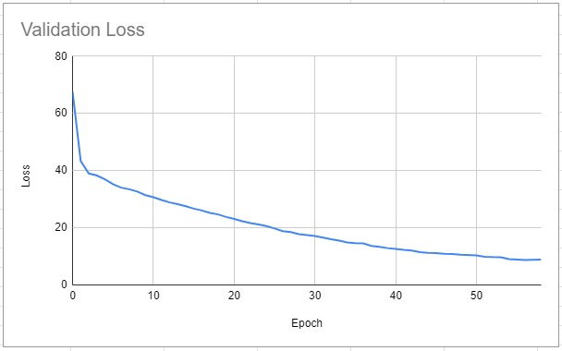
Results & Discussion
Hyperparameters: learning rate= 0.001, momentum= 0.9 and weight decay= 0.0005
Loss starts to increase at around 55 epochs
Cut the training there

Slide 13
Results & Discussion
Using only mangoes
After training for 50 epochs
Accurate model for counting mangoes
Correct classification and region proposals
Training: The model was initially trained on a dataset of mango images obtained from ACFR, achieving a strong performance in mango detection.
Sample output after training on mangoes

Slide 14
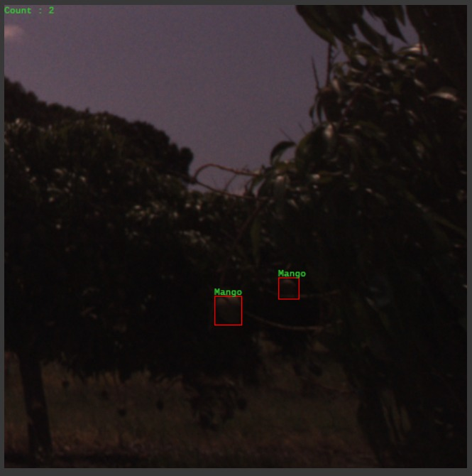
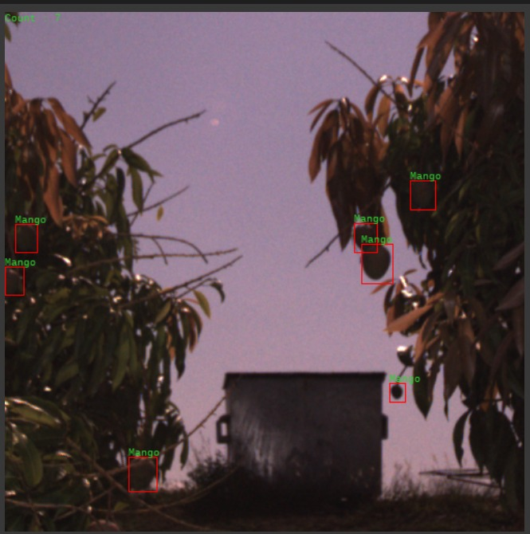
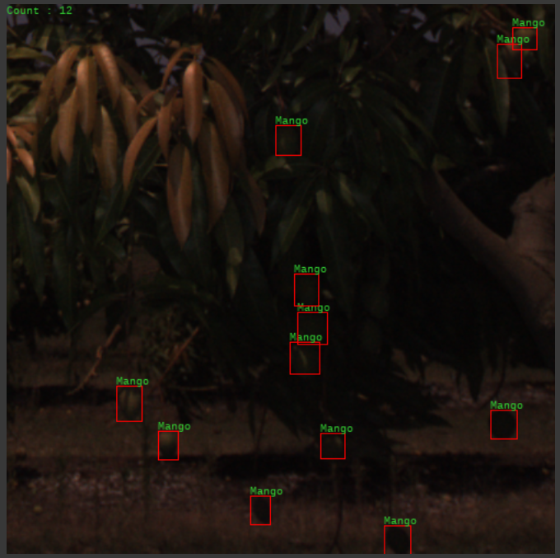
Results & Discussion
More sample outputs using mangoes:
Count: 2
Count: 7
Count: 12

Slide 15
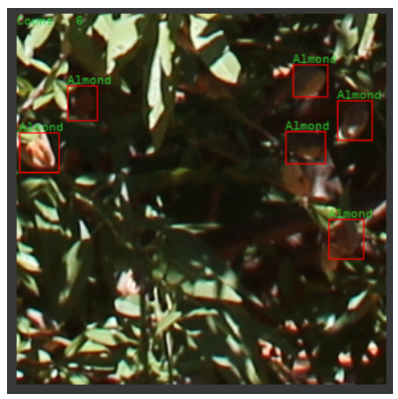
Results & Discussion
Using almonds
After training for 50 epochs with the same hyperparameters
Correct classification and bounding box estimation
Accurate model for counting both mangoes and almonds
Transfer Learning: Leveraging the pre-trained model, transfer learning techniques were applied to fine-tune it on a separate dataset of almond images, enabling accurate detection of both mangoes and almonds.
Sample output after training on almonds

Slide 16
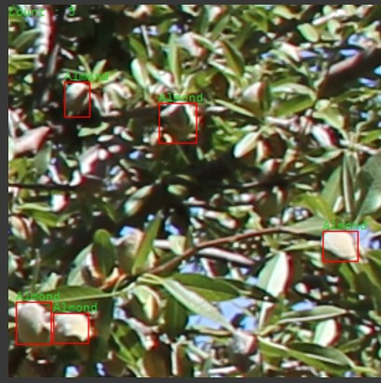
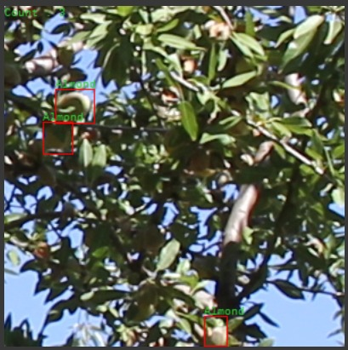
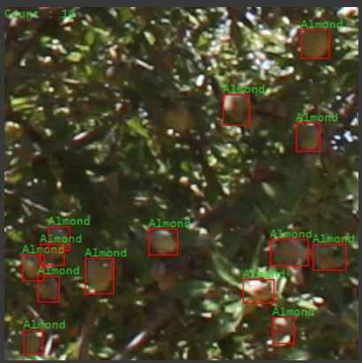
Results & Discussion
More sample outputs using almonds:
Count: 5
Count: 3
Count: 14

Slide 17
References
[1] Tan, L., Huangfu, T., Wu, L. et al. Comparison of RetinaNet, SSD, and YOLO v3 for real-time pill identification. BMC Med Inform Decis Mak 21, 324 (2021). https://doi.org/10.1186/s12911-021-01691-8
[2] J. Redmon, S. Divvala, R. Girshick and A. Farhadi, "You Only Look Once: Unified, Real-Time Object Detection," 2016 IEEE Conference on Computer Vision and Pattern Recognition (CVPR), Las Vegas, NV, USA, 2016, pp. 779-788, doi: 10.1109/CVPR.2016.91.
[3] Liu, W. et al. (2016). SSD: Single Shot MultiBox Detector. In: Leibe, B., Matas, J., Sebe, N., Welling, M. (eds) Computer Vision – ECCV 2016. ECCV 2016. Lecture Notes in Computer Science(), vol 9905. Springer, Cham. https://doi.org/10.1007/978-3-319-46448-0_2
[5] Shaoqing Ren, et al. "Faster R-CNN: Towards Real-Time Object Detection with Region Proposal Networks." In Advances in Neural Information Processing Systems (NIPS), 2015. (Original paper introducing Faster R-CNN)
A. S. Gomez, E. Aptoula, S. Parsons and P. Bosilj, "Deep Regression Versus Detection for Counting in Robotic Phenotyping," in IEEE Robotics and Automation Letters, vol. 6, no. 2, pp. 2902-2907, April 2021, doi: 10.1109/LRA.2021.3062586.
Songa, Y., et al. “Automatic Fruit Recognition and Counting from Multiple Images.” Sciencedirect, Sciencedirect.

Slide 18
References
J. -a. Kim, J. -Y. Sung and S. -h. Park, "Comparison of Faster-RCNN, YOLO, and SSD for Real-Time Vehicle Type Recognition," 2020 IEEE International Conference on Consumer Electronics - Asia (ICCE-Asia), Seoul, Korea (South), 2020, pp. 2, doi: 10.1109/ICCE-Asia49877.2020.9277040.
Liu, W., Anguelov, D., Erhan, D., Szegedy, C., Reed, S., Fu, C., & Berg, A. C. (2015). SSD: Single Shot MultiBox Detector. ArXiv. https://doi.org/10.1007/978-3-319-46448-0_2
L. Zhang and D. Zhang, "Robust Visual Knowledge Transfer via Extreme Learning Machine-Based Domain Adaptation," in IEEE Transactions on Image Processing, vol. 25, no. 10, pp. 4959-4973, Oct. 2016, doi: 10.1109/TIP.2016.2598679.
P. Oza, V. A. Sindagi, V. V. Sharmini and V. M. Patel, "Unsupervised Domain Adaptation of Object Detectors: A Survey," in IEEE Transactions on Pattern Analysis and Machine Intelligence, doi: 10.1109/TPAMI.2022.3217046.

